Slide 1
Structure of Processes

Slide 2
Kernel Architecture (UNIX)
User program
Library
User level
system call interface
kernel level
File Subsystem
Inter process
communication
Buffer Cache
Process Control
Subsystem
Scheduler
Memory Management
character block
Device driver
Hardware control
kernel level
hardware
Hardware level

Slide 3
PROCESS SUB SYSTEM
A process is the execution of a program.
Process consists of a pattern of bytes that the CPU interprets as machine instructions (called as text), data and stack.
Many processes appear to execute simultaneously as the kernel schedules them for execution.
Several processes may be instances of one program.
A process may read and write its data and stack sections, but it cannot read or write the data and stack of other processes.
Processes communicate with other processes via system calls.
A process on Unix system is created by the fork system call.
The process that invoked the fork system call is the parent process, and newly created process is the child process.

Slide 4
PROCESS SUB SYSTEM
The kernel identifies each process by its process number, called the PID, process ID.
Executable file consists of several parts:
A set of headers that describe the attributes of the file,
The program text, A machine language representation of data that has initial values when the program starts execution, and an indication of how much space the kernel should allocate for uninitialized data (bss).
Other sections, such as symbol table information.
e.g. char buffer[2048]; //uninitialized data
int version = 1; // initialized data

Slide 5
PROCESS SUB SYSTEM
The kernel loads an executable file into memory during an exec system call, and the loaded process consists of at least three parts called regions
Text
Data
Stack

Slide 6
PROCESS SUB SYSTEM
The text and data regions corresponds to the text and data bss (block started by symbols) sections of the executable file, but the stack region is automatically created and its size is dynamically adjusted by the kernel at runtime.

Slide 7
PROCESS SUB SYSTEM
The stack consists of logical stack frames that are pushed when calling a function and popped when returning.
A special register called the stack pointer indicates the current stack depth.
A stack frame contains the parameters to a function, its local variables, and the data necessary to recover the previous stack frame, including the value of the program counter and stack pointer at the time of the function call.

Slide 8
PROCESS SUB SYSTEM
A process in the Unix system can execute in two modes, kernel or user mode.
Therefore it uses a separate stack for each mode.
The user stack contains the arguments, local variables, and other data for functions executing in user mode.
The kernel stack contains the stack frames for functions executing in kernel mode.

Slide 9
Mode of Process Execution(1)
The UNIX process runs in two modes:
User mode
Can access its own instructions and data, but not kernel instruction and data
Kernel mode
Can access kernel and user instructions and data
When a process executes a system call, the execution mode of the process changes from user mode to kernel mode

Slide 10
Mode of Process Execution(2)
When moving from user to kernel mode, the kernel saves enough information so that it can later return to user mode and continue execution from where it left off.
Mode change is not a context switch, just change in mode.

Slide 11
Process: U Area
Every process has an entry in the kernel process table, and each process is allocated a u area – contains private data manipulated only by the kernel.
Internally, the kernel references the structure variable u to access the u area of the currently running process.
When another process executes, the kernel rearranges its virtual address space so that the structure u refers to the u area of the new process.

Slide 12
Process: U Area
U Area is the extension of process table entry.
Fields of process table entry:
State field
User ID (UID) indicating the owner of the process
pointers to the text, data, stack and the U Area of a process
Control and status info of process
Fields of U Area
Pointer to process table entry
Parameters of the current system calls, return values and error codes
File descriptors of all open files
Current directory and current root
I/O parameters
Process and file size limit
Kernel can directly access fields of the U Area of the executing process but not of the U Area of other processes

Slide 13
Processes(2)
Kernel has a process table that keeps track of all active processes
Each entry in the process table contains pointers to the text, data, stack and the U Area of a process.
All processes in UNIX system, except the very first process (swapper process 0) which is created by the system boot code, are created by the fork system call
The process table entry and the u area contain control and status information about the process.

Slide 14
PROCESS SUB SYSTEM
The process table contains (or points to) a per process region table, whose entries point to entries in a region table.

Slide 15
Kernel Support for Process
Kernel Process Table
Region Table
A Process
Per Process Region Table
Text
File Descriptor Table
Data
Stack
U Area

Slide 16
Process: Region Table
A region is a contiguous area of a process address space, such as text, data and stack.
Region table entries describe the attributes of the region, such as whether it contains text or data, whether it is shared or private, and where the data of the region is located in memory.
The extra level of indirection (from the per process region table to the region table) allows independent processes to share regions.

Slide 17
Process: Region Table
When a process invokes the fork, the kernel duplicates the address space of the old process, allowing processes to share regions when possible and making a physical copy otherwise.
When invokes the exec system call, the kernel allocates regions for its text, data and stack after freeing the old regions the process had been using.
When a process invokes exit, the kernel frees the regions the process had used.

Slide 18
Process States and State Transitions
The life time of a process can be divided into a set of states, each with certain characteristics that describes the process.
Nine different states of a process
State transitions of a process – process moving from one state to another

Slide 19
Process States and Transitions
The life time of a process can be conceptually divided into a set of states that describes the process.
The following list contains the complete set of process states :
The process is executing in user mode.
The process is executing in kernel mode.
The process is not executing but is ready to run as soon as the kernel schedules it.
The process is sleeping and resides in main memory.
The process is ready to run, but the swapper (process 0) must swap the process into main memory before the kernel schedule it to execute.
The process is sleeping , and the swapper has swapped the process to secondary storage to make room for other processes in main memory .

Slide 20
Process States and Transitions
The process is returning from the kernel to user mode, but the kernel preempts it and does a context switch to schedule another process.
The process is newly created and is in a transition state; the process exists, but it is not ready to run, nor is it sleeping .
This state is the start state for all processes except process 0.
The process executed the exit system call and is in the zombie state, the process no longer exists, but it leaves a record containing an exit code and some timing statistics for its parent process.

Slide 21
Process State Transition Diagram
User Running
interrupt,
interrupt return
1
system call,
interrupt
return
to user
return
Kernel
Running
Preempted
exits
2
7
9
preempt
reschedule
process
Zombie
sleep
4
3
Ready to
Run in Memory
Asleep
in
Memory
wakeup
enough mem
Created
fork
swap
out
8
swap
out
swap
in
6
5
not enough mem
(swapping system only)
wakeup
Sleep, Swapped
Ready to Run, Swapped

Slide 22
Process States and Transitions
Consider a typical process as it moves through the state transition model.
The process enters the state model in the “created” state when the parent processes execute the fork system call and eventually moves into a state where it is “ready to run” (3 or 5).
Assume, the process enters the state “ready to run in memory” (3).
The process scheduler will eventually pick the process to execute, and the Process enters the state “kernel running” (2) Where it completes its part of the fork system call.
When the process completes the system call, it may move to the state, “user running” (1), where it executes in user mode.
After a period of time, the system clock may interrupt the processor, and the process enters the state “kernel running” (2) again

Slide 23
Process States and Transitions
When the clock interrupt handler finishes servicing the clock interrupt, the kernel may decide to schedule another process to execute, so the first process enters state “preempted” (7) and the other process executes.
The state “preempted’ is same as the state “ready to run in memory”, but they are depicted separately to stress that a process executing in kernel mode can be preempted only when it is about to return to user mode.
Consequently, the kernel could swap a process from the state “preempted” if necessary.
Eventually, the scheduler will choose the process to execute, and it returns to state “user running“(1), executing in user mode.

Slide 24
Process States and Transitions
When a process executes a system call, it leaves the state “user running” (1) and enters the state “kernel running” (2).
Suppose the system call requires i/o from the disk, and the process must wait for the I/O to complete.
It enters the state “asleep in memory” (4) putting itself to sleep until it is notified that the I/O has completed.
When the I/O later completes, the hardware interrupts the CPU, and the interrupt handler awakens the process, causing it to enter the state “ready to run in memory” (3).
Suppose the system is executing many process that do not fit simultaneously into main memory, and the swapper(process 0) swaps out the process to make room for another process that is in the state “ready to run swapped” (5).

Slide 25
Process States and Transitions
When evicted from main memory, the process enters the state “ready to run swapped” (5).
Eventually the swapper chooses the process as the most suitable to swap into main memory, and the process reenters the state “ready to run in memory” (3).
The scheduler will eventually choose to run the process and it enters the state “kernel running (2) and proceeds.
When a process completes it invokes the exit system call, thus entering the states “kernel running” (2) and finally the “zombie” (9) state.

Slide 26
Process States and Transitions
The process has control over some state transitions at user-level,
First, a process can create another process
However, the state transitions the process takes from the “created” state to the state “ready to run in memory” or “ready to run swapped” depend on the kernel.
The process has no control over those state transitions.

Slide 27
Process States and Transitions
Second, a process can make system call to move from state ‘user running” to the state “kernel running” and enter the kernel of its own violation.
However the process has no control over when it will return from the kernel”.
Events may dictate that it never returns but enter the zombie state.
Finally, a process can exit of its own violation
But as indicated before, external events may dictate that it exits without explicitly invoking the exit system call.
No process can preempt another process executing in the kernel.

Slide 28
Process States and Transitions
Two kernel data structures describe the state of a process:
The process table entry - contains fields that must always be accessible to the kernel
The “U” area - contains fields that need to be accessible only to the running process. So, the kernel allocates space for the “U” area only when creating a process.

Slide 29
Process States and Transitions
The fields in the process table are following:
The state field identifies the process state.
The process table entry contains fields that allow the kernel to locate the process and its “U” area in main memory or in secondary storage.
The kernel uses this information to do a context switch to the process when the process moves from state “ready to run in memory” to the state “kernel running” or from the state “preempted” to the state “user running”.
It uses this information when swapping(or paging) process to and from the memory (between the two in memory states and two “swapped” states)
The process table entry also contains a field that gives the process size, so that the kernel knows how much space to allocate for the process.

Slide 30
Process States and Transitions
Several user identifiers (user IDs or UIDs) determine various process privileges.
For e.g. UID fields define the set of processes that can send signals to each other.
Process identifiers (PIDs) specify the relationship of processes to each other. These ID fields are set up when the process enters the state “created” in the fork system call.
The process table entry contains an event descriptor when the process is in the “sleep” state.
Scheduling parameters allow the kernel to determine the order in which process move to the states “kernel running” and “user running”.
A signal field enumerates the signal sent to a process but not yet handled.
Various timers give process execution time and kernel resource, utilization, used for process accounting and for calculation of process scheduling priority.
One field is a user-set timer – used to send an alarm signal to process.

Slide 31
Process States and Transitions
The U area contains the following fields that further characterize the process states.
A pointer to the process table identifies the entry that corresponds to the U area.
The real and effective UIDs determine various privileges allowed the process, such as file access rights.
An array indicates how the process wishes to react to signals.
The control terminal field identifies the login terminal associated with the process if one exists.
Timer fields record the time the process and its descendants spent executing in user mode and in kernel mode.
An error field records the errors encounter during a system call.
A return value field contains the result of system call.
I/O parameter describes the amount of data to transfer to the address of the source (or target) data array in user space, file offset for I/O and so on.

Slide 32
Process States and Transitions
The current directory and current root describe the file system environment of the process.
The user file descriptor table records the files the process has open.
Limit fields restrict the size of a process and the size of a file it can write.
A permission modes field masks mode settings on files the process creates.
Thus the process state transition on a logical level has been described. Each state has physical characteristics managed by the kernel, particularly the virtual address space of the process.

Slide 33
Process Context
The context of a process is its state:
The values of its global user variables and data structures.
The values of machine registers it uses,
The values stored in its process table slot and u area, and The contents of its user and kernel stack
Text, data( variable), register
Process region table, U Area,
User stack and kernel stack
When executing a process, the system is said to be executing in the context of the process

Slide 34
Saving Context of Process - Context Switch
When the kernel decides that it should execute another process, it does a context switch, so that the system executes in the context of the other process
When doing a context switch, the kernel saves enough information so that it can later switch back to the first process and resume its execution.

Slide 35
Saving Context of Process -Mode Switch
Similarly, when moving from user to kernel mode, the kernel saves enough information so that it later returns to user mode and continues
It also changes execution mode from user to kernel or from kernel to user, still executing in the context of one process, such as process A.
The kernel services interrupts in the context of the interrupted process even though it may not have caused the interrupt.
The interrupted process may have been executing in user mode or in kernel mode.
The kernel saves enough information so that it can later resumes execution of the interrupted process and services the interrupt in kernel mode.

Slide 36
Saving the Context of a Process
The kernel saves the context of a process in 3 situations:
when the system receives an interrupt
when a process executes a system call
when the kernel does a context switch

Slide 37
Saving the Context of a Process
Saving Context of a Process
1. Interrupts and Exceptions
The system is responsible for handling interrupts
from hardware (such as from the clock or from peripheral devices),
from a programmed interrupt (execution of instructions designed to cause “software interrupt”), or
from exceptions.
If the CPU is executing at a lower processor execution level than the level of the interrupt it accepts the interrupt before decoding the next instruction and raises the processor execution level, so that no other interrupts of the level (or lower level) can happen while it handles the current interrupt, preserving the integrity of the kernel data structure.

Slide 38
Saving the Context of a Process
The kernel handles the interrupt with the following sequence of operations:
It saves the current register context of the executing process and creates (pushes) a new context layer.
It determines
the “source” or cause of the interrupt,
identifying the type of interrupt (such as clock or disk) and
the unit number of the interrupt, if applicable (such as which disk drive caused the interrupt).
When the system receives an interrupt, it gets a number from the machine that it uses as an offset into a table known as interrupt vector.
The contents of interrupt vector vary from machine to machine, but they usually contain the address of the interrupt handler for the corresponding interrupt source, and a way of finding a parameter for the interrupt handler.

Slide 39
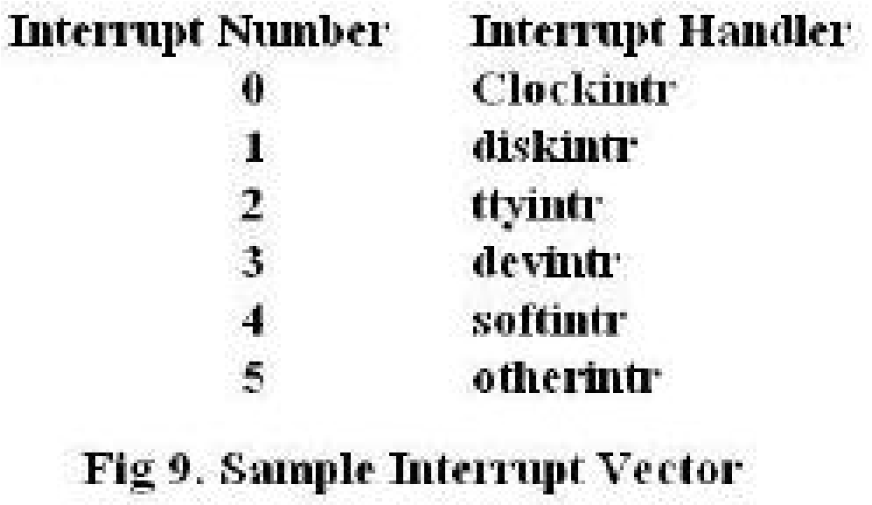
Saving the Context of a Process

Slide 40
Saving the Context of a Process
If a terminal interrupts the system, the kernel gets the interrupt number 2 from the hardware and invokes the terminal interrupt handler ttyintr.
The kernel invokes the interrupt handler.
The kernel stack for the new context layer is logically distinct from the kernel stack of the previous context layer.
Some implementations use the kernel stack of the executing process to store the interrupt handler stack frames, and other implementations use a global interrupt stack to store the frames for the interrupt handlers that are guaranteed to return without switching context.

Slide 41
Saving the Context of a Process
The interrupt handler completes its work and returns.
The kernel executes a machine-specific sequence of instructions that restores the register context and kernel stack of the previous context layer, as they existed at the time of the interrupt and then resumes execution of the restored context layer.
The behavior of the process may be affected by the interrupt handler, since the interrupt handler may have altered the global kernel data structures and awakened sleeping process.
Usually the process continues execution as if the interrupt had never happened.

Slide 42
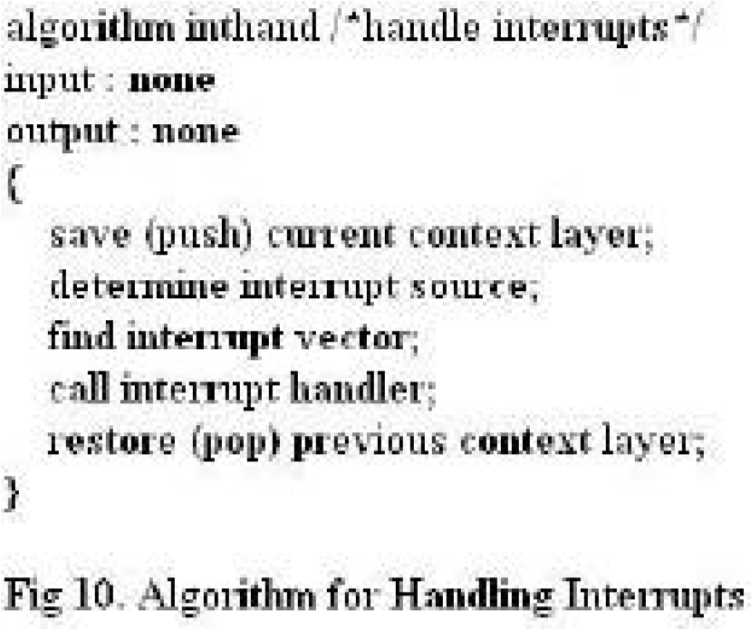
Saving the Context of a Process
While executing the disk interrupt handler, the system receives a clock interrupt and executes the clock interrupt handler.
Every time the system receives an interrupt (or makes a system call), if creates a new context layer and saves the register context of the previous layer.

Slide 43
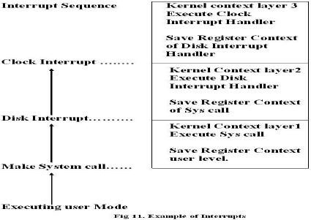

Saving the Context of a Process

Slide 44
Saving the Context of a Process
2. System Call Interface
The System call is a normal function call.
The usual calling sequence cannot change the mode of a process from user to kernel. The C compiler uses a predefined library of functions that have the names of the system calls, thus resolving the system call references in the user program.
The library functions typically invoke an instruction that changes the process execution mode to kernel mode and causes the kernel to start executing code for system calls.
The library routines execute in user mode, but the system call interface is a special case of an interrupt handler.
The library functions pass the kernel a unique number per system call in a machine dependent way-either as a parameter to the operating systems trap, in a particular register, or on the stack- and the kernel thus determines the specific system call the user is invoking.

Slide 45
Saving the Context of a Process
In handling the operating system trap, the kernel looks up the system call number in a table to find the address of the appropriate kernel routine that is the entry point for the system call and to find the number of parameters the system call expects (figure 12).
The kernel calculates the (user) address of the first parameter to the system call by adding or subtracting, depending on the direction of the stack growth) an offset to the user stack pointer, corresponding to the number of parameters to the system call.
Finally, it copies the user parameters to the u area and calls the appropriate routine. After executing the code for the system call, the kernel determines whether there was error.

Slide 46
Saving the Context of a Process
If so, it adjusts the register locations in the saved user register content, typically setting the “carry bit” for the PS register and copying the error number into the register 0 location.
If there were no errors in the execution of the system call, the kernel clears the “carry bit” in the PS register and copies the appropriate return values from the system call into the locations for registers 0 and 1 in the saved user register context.
When the kernel returns from the operating system trap to user mode, it returns to the library instruction after the trap.
The library interprets the return values from the kernel and returns a value to the user program.

Slide 47
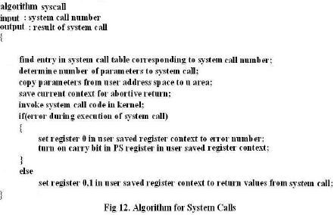
Saving the Context of a Process

Slide 48
Saving the Context of a Process
3. Context Switch:
The kernel permits a context switch under four circumstances:
when a process puts itself to sleep,
when it exits,
when it returns from a system call to user mode but is not the most eligible process to run,
when it returns to user mode after the kernel completes handling an interrupt but is not the most eligible process to run.

Slide 49
Saving the Context of a Process
The kernel ensures integrity and consistency of internal data structures by prohibiting arbitrary context switches. It makes sure that the state of its data structures is consistent before it does a context switch:
that all appropriate updates are done,
that queues are properly linked,
that appropriate locks are set to prevent intrusion by other processes,
that no data structures are left unnecessarily locked and so on.

Slide 50
Saving the Context of a Process
For e.g.
If the kernel allocates a buffer, reads a block in a file, and goes to sleep waiting for I/O transmission from the disk to complete, it keeps the buffer locked so that no other process can tamper with the buffer.
But if a process executes the link system call, the kernel releases the lock of the first inode before locking the second inode to avoid deadlock.
The kernel must do a context switch at the conclusion of the exit system call, because there is nothing else for it to do.
Similarly, the kernel allows a context switch when a process enters the sleep state, since a considerable amount of time may elapse until the process wakes up, and other processes can meanwhile execute.

Slide 51
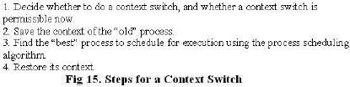
Saving the Context of a Process

Slide 52
Saving the Context of a Process
The kernel allows a context switch when a process is not the most eligible to run to permit fairer process scheduling:
If a process completes a system call or returns from an interrupt and there is another process with higher priority waiting to run, it would be unfair to keep the higher priority process to waiting.
The procedure for a context switch is similar to the procedures for handling interrupts and system calls, except that the kernel restores the content layer of a different process instead of the previous context layer of the same process.
Similarly, the choice of which process to schedule next is a policy decision that does not affect the mechanics of the context switch.

Slide 53
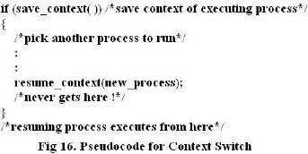
Saving the Context of a Process

Slide 54
Saving the Context of a Process
Copying data between system and user address space:
A process executes in kernel mode or in user mode with no overlap of modes.
Many system calls move data between kernel and user space, such as when copying system call parameters from user to kernel space or when copying data from I/O buffers in the read system call.
Many machines allow the kernel to reference addresses in user space directly.
The kernel must ascertain, that the address being read or written is accessible as if it had been executing in user mode;
Otherwise it could override the ordinary protection mechanisms and inadvertently read or write addresses outside the user address space (possibly kernel data structure).

